Slide 1
The Honors Program at Wes

Slide 2
Agenda/Topics to Be Covered
Introductions
General Expectations
Keys to Success
Resources Available
Honors Portal/Handbook
Things to Keep in Mind
Questions?
Contact Information

Slide 3
Introductions
Amanda Daddona, Honors Coordinator
Kendall Hobbs, Social Sciences and Instruction Librarian
Crystal Rose Hill-Farrell, Director of Student Academic Resources
Kelly Dunn, 2025 Class Dean

Slide 4
General Expectations
Departmental Honors
Registration
Writing for more than one department
Writing two separate theses

Slide 5
Keys to Success
Passion for your project
Time management
Communication with advisors
Taking advantage of available resources

Slide 6
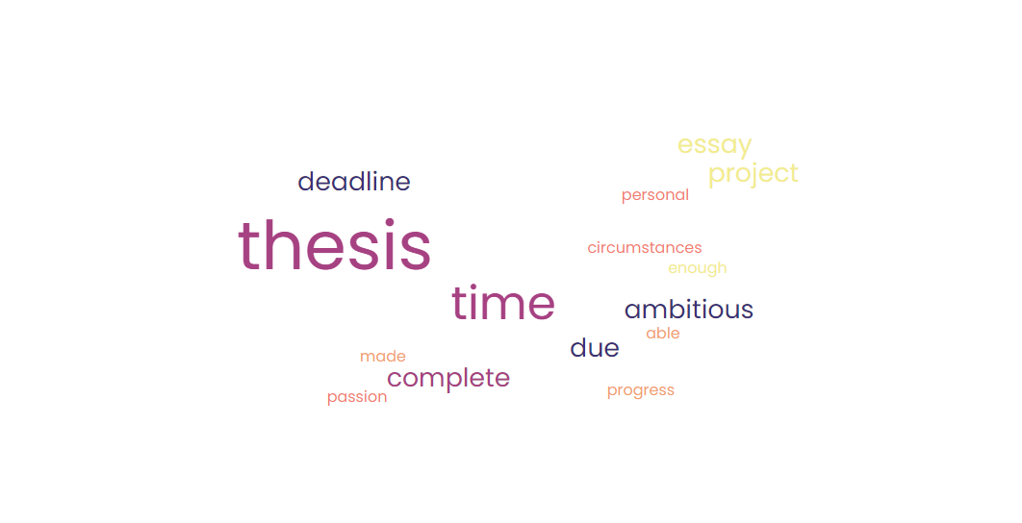
It’s Okay to Downgrade or Drop
There are many reasons why students discontinue thesis work… and it’s all okay!
Notes:
Not enough progress made.
I was not able to complete the thesis in time for the deadline due to personal circumstances.
Too ambitious for myself and no passion towards the project anymore.
No time to complete written portion of thesis due to extracurricular commitments.
Time constraints
Bad planning and work habits have rendered the thesis deadline not feasible.
I want to develop a more tightly-focused project and think a thesis constitutes a too ambitious trajectory.
Time management. Also, a conversion to an essay makes sense based on the nature of the subject matter.
After discussing the scope of my thesis with my advisor, we have decided that it would be best for me to downgrade my thesis to a senior essay.
I did not retain the same level of interest in my chosen topic as I anticipated.
-Getting into MA program

Slide 7
Resources
Library - Research Guides & Personal Research Help
Student Academic Resources & Academic Peer Advisors
Writers Room & Peer Tutors and Mentors
WesWell - WesWell Health Links
Counseling and Psychological Services (CAPS)
Office of Religious and Spiritual Life (ORSL)
Class Dean
Honors Coordinator
Thesis Advisors

Slide 8
Resources, cont’d
Video Introductions to Digital Tools by Peer Technology Specialists
Digital Tools Demos & Resource Links
Writing Center Thesis Support
Olin Resources for Thesis and Essay Writers

Slide 9
Honors Program Links
WesPortal
  Honors Management System
Honors Website
  Honors Deadlines
  Honors Program Handbook
  Forms
  Resources

Slide 10
Keep in Mind…
Use Microsoft Word whenever possible
  Office365 allows document sharing
Choose your citation method early on and stick with it!
Start the pdf formatting process as soon as possible
We’re here to help ☺

Slide 11
Questions?

Slide 12
Contact Information
Amanda Daddona
  adaddona@wesleyan.edu
Crystal Rose Hill-Farrell
  chill01@wesleyan.edu
Kendall Hobbs
  khobbs@wesleyan.edu
Dean Dunn
  kmdunn@wesleyan.edu

